Slide 1
TEAM MEMBER:
NAME: SIRISETTI SUDHEER KUMAR
ROLL.NO: 322129512055

Slide 2
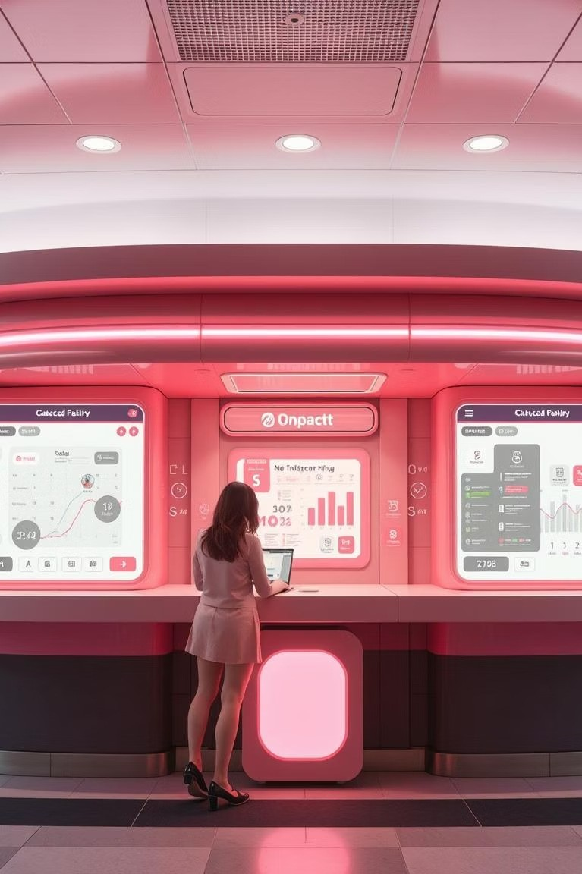
Revolutionizing Loan Eligibility With AI/ML
Unlocking the future of lending through intelligent automation and data-driven decisions.

Slide 3
Agenda
Streamlining the Lending LandScape
01 02
03
The Current Challenge
Identifying inefficiencies in traditional loan processes.
AI/ML Solution OvervieW
Introducing automated loan eligibility prediction.
Key FeatureS & BenefitS
Exploring the advantages for financial institutions.
04
05
Implementation & Impact
Real-world application and expected outcomes.
Call to Action
Partnering for a smarter lending future.

Slide 4

The BottleneckS of Traditional Loan ProceSSing
Financial institutions grapple with thousands of loan applications monthly, each demanding meticulous scrutiny. The current process is fraught with challenges:
Manual Verification: Extensive paperwork and human checks are time-consuming.
Human Error: Subjectivity can lead to inconsistencies and mistakes.
Inconsistent Decisions: Lack of standardized evaluation criteria.

Slide 5
Our ViSion: Automated Loan Eligibility
"To develop an automated system that precisely predicts loan eligibility based on applicant features, enabling banks to make faster, data-driven, and reliable decisions while significantly minimizing default risks."
This project aims to transform the conventional loan approval process into a streamlined, efficient, and objective system.

Slide 6
HoW AI/ML DriveS Loan EligiBility
Data Input
AI/ML Model
Output
Model Refinement
Our machine learning model processes a diverse set of applicant data to determine loan eligibility, providing a clear "Approved" or "Rejected" outcome.

Slide 7




Key FeatureS of Our Solution
Data-Driven InSightS
Leveraging comprehensive data points for accurate predictions.
Accelerated DeciSionS
Significantly reducing loan processing times from days to minutes.
RiSk Minimization
Identifying potential defaults with higher precision.
Scalable OperationS
Handling large volumes of applications without compromising quality.

Slide 8
Enhanced DeciSion-Making FactorS
Our AI/ML model evaluates a robust set of features to ensure comprehensive and fair assessment of loan applicants.
Income Stability: Analyzing regular income sources.
Employment Status: Assessing job security and history.
Credit History: Evaluating past repayment behavior.
Loan Amount & Purpose: Understanding financial needs.
Debt-to-Income Ratio: Measuring repayment capacity.
Applicant Demographics: Non-discriminatory data points.

Slide 9


Projected Impact: Operational Efficiency & RiSk Reduction
450
300
150
0
Approval Time (Days)
Default Rate Reduction...
Traditional Process AI/ML Automated
Manual Hours Saved...
The bar chart illustrates the significant improvements our AI/ML solution brings, including drastically reduced approval times, a projected 15% reduction in default rates, and substantial savings in manual processing hours.

Slide 10
Strategic AdvantageS for Financial InStitutionS
Enhanced CuStomer Experience
Faster approvals lead to higher satisfaction and loyalty.
IncreaSed Profitability
Lower operational costs and reduced risk directly impact the bottom line.
Competitive Edge
Positioning your institution as an innovative market leader.

